Slide 1
The beauty I see in Algebra
Margot Gerritsen
Compilado por Ariel Guerrero @13/01/2018

Slide 2

𝑦 − 𝑧 = 0
𝑥 + 𝑦 | = | 2 | 𝑥 | = | 2 − 𝑦 | 𝑥 | = | 2 − 𝑦
 |  |  |  |  |  |  |  | 𝑦
𝑥 + 𝑦 + 𝑧 | = | 3 | 𝑥 + 𝑦 + 𝑧 | = | 3 | 𝑥 + 𝑦 + 𝑧 | = | 3
!
!
𝑦 − 𝑧 = 0 !
𝑧
=
¿Encuentre x,y,z?
2 − 𝑦 + 𝑦 + 𝑦 = 3
2+𝑦 = 3
𝑦 = 3 − 2
𝑥 = 1
!𝑦 = 1
𝑧 = 1
implica
𝑦 = 1

Slide 3
−2𝑧 + 8𝑤 + 19𝑏 = 0
−10𝑟 + 120𝑣 − 80𝑎 + 15𝑏 = −100 8𝑥 + 𝑡 + 𝑤 = 3
𝑦 − 𝑤 = 200
5𝑠 + 10𝑤 + 15𝑏 = 20
3𝑧 − 𝑣 + 𝑤 − 2𝑎 = 17
111𝑥 + 225𝑦 − 340𝑟 = 0
𝑥 + 2𝑧 − 26𝑠 + 44𝑤 − 127𝑏 = 341
𝑦 − 2𝑠 = 3
−𝑥 + 𝑦 − 14𝑠 + 21𝑣 − 8𝑎 + 16𝑏 = 400

Slide 4
𝑥 + 𝑦
𝑦
𝑥 + 𝑦
 |  |  | = | 2
− |  | 𝑧 | = | 0
+ |  | 𝑧 | = | 3
 | + |  | 𝟎 𝒛 | = | 2
 | − |  | 𝑧 | = | 0
 | − |  | 𝑧 | = | 3
!
𝑥 + 𝑦
! 𝟎 𝒙 + 𝑦
𝑥 + 𝑦
𝑥 + 𝑦 = 2
𝑦 − 𝑧 = 0
𝑥 + 𝑦 + 𝑧 = 3
!
(𝟏)𝑥 | + | (𝟏)𝑦 | + | 𝟎 𝑧 | =
H 𝟎 𝑥 | + | (𝟏)𝑦 | + | (−𝟏)𝑧 | =
(𝟏)𝑥 | + | (𝟏)𝑦 | + | (𝟏)𝑧 | =
(𝟏)𝒙 | + | (𝟏)𝑦 | + | 𝟎 𝑧
H 𝟎 𝒙 | + | (𝟏)𝑦 | + | (−𝟏)𝑧
(𝟏)𝒙 | + | (𝟏)𝑦 | + | (𝟏)𝑧
2
0
3

Slide 5
𝑥 + 𝑦 − 𝑧 = 3
 | 𝑥 + 𝑦 | = | 2 | (𝟏)𝒙 | + | (𝟏)𝑦 | + | 𝟎 𝑧
! | 𝑦 − 𝑧 | = | 0 | H 𝟎 𝒙 | + | (𝟏)𝑦 | + | (−𝟏)𝑧
(𝟏)𝒙
(𝟏)
H 𝟎 (𝟏)
(𝟏)
H 𝟎 (𝟏)
+ (𝟏)𝑦
+ (𝟏)𝒚
+ (𝟏)𝒚
+ (𝟏)𝒚
+
+
+
+ (𝟏)𝑧
+ 𝟎 𝑧 𝒙
+ (−𝟏)𝑧
+ (𝟏)𝑧
+ 𝟎 𝒛 𝑥
+ 𝒚
+
(𝟏)
(𝟏)
(𝟏)
(−𝟏)𝒛 (𝟏)𝒛
(𝟏) + (𝟏) H 𝟎 + (𝟏) (𝟏) + (𝟏)
+ 𝟎 𝑥
+ (−𝟏) 𝒚
+ (𝟏) 𝒛

Slide 6









𝑥 + 𝑦 = 2
𝑦 − 𝑧 = 0
𝑥 + 𝑦 − 𝑧 = 3
(𝟏) + (𝟏) H 𝟎 + (𝟏) (𝟏) + (𝟏)
+ 𝟎 𝑥
+ (−𝟏) 𝑦
+ (𝟏) 𝑧
!
1 1 0
0 1 −1
1 1 1
𝑥
𝑦
𝑧
2
0
3
=
𝐴𝑥 = 𝑏

Slide 7
2
0
0
0 1 0 0
1 0 0 0
1 2 0 0
1 2 3 4 5
2 3 4 5 6
3 4 5 6 7
0 | 0 | 0 | 1 | 0 |  | 4 | 5 6 | 7 | 8
0 | 1 | 0 | 0 | 2 |  | 5 | 6 7 | 8 | 9
Matriz sparsa
Matriz simétrica
2 | −1 | 0 | 1 | 0 | 0
−1 | 2 | −1 | 0 | 1 | 0
0 | −1 | 2 | 0 | 0 | 1
1 | 0 | 0 | 2 | −1 | 0
0 | 1 | 0 | −1 | 2 | −1
0 | 0 | 1 | 0 | −1 | 2
 |  |  | 1 | 0 | 0 | 2 | −1 | 0
 |  |  | 0 | 1 | 0 | −1 | 2 | −1
 |  |  | 0 | 0 | 1 | 0 | −1 | 2
2 | −1 | 0 | 0 | 0 | 0
−1 | 2 | −1 | 0 | 0 | 0
0 0 0 | −1 0 0 | 2 −1 0 | −1 2 −1 | 0 −1 2 | 0 0 −1
0 | 0 | 0 | 0 | −1 | 2
Matriz simétrica y sparsa

Slide 8
1 100
100 1001
Matrices mal condicionadas

Slide 9



1 0 1 0
0 1 0 1
1 2 3 4
1 1 0 1 0
2 0 1 0 1
3 1 0 1 1
4 1 1 1 1
1 2 3 4
1 1 0 1 0
2 0 1 0 1
3 1 0 1 1
4 1 1 1 1
1
1 0 1 1
1 1 1 1
4
2
3
1 2 3 4
1 1 0 1 0
2 0 1 0 1
3 1 0 1 1
4 1 1 1 1
1 2 3 4
1 1 0 1 0
2 0 1 0 1
3 1 0 1 1
4 1 1 1 1

Slide 10
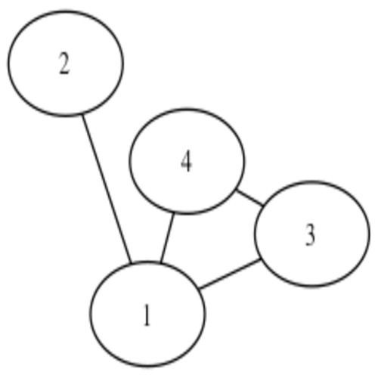
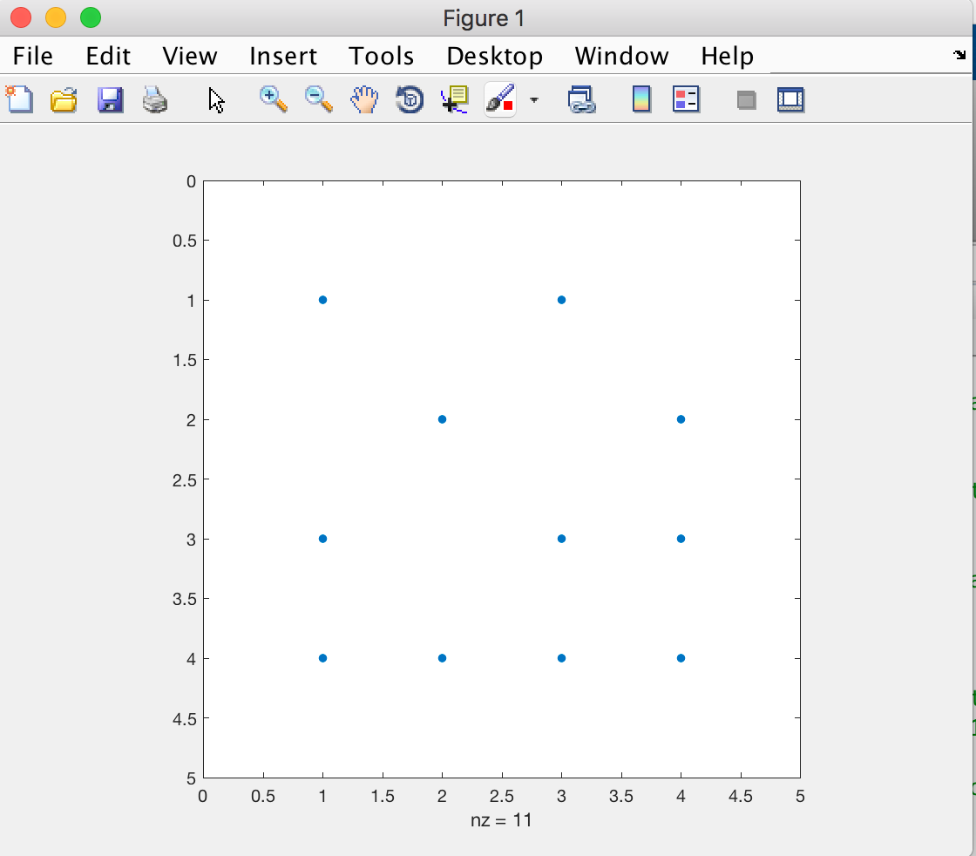
1 0 1 0
0 1 0 1
1 0 1 1
1 1 1 1
1
3
2
4
>>A=[[1 0 1 0];[0 1 0 1];[1 0 1 1];[1 1 1 1]];
>>spy(A)
3
2
4
1
 | 1 | 2 | 3 | 4
1 | 1 | 0 | 1 | 0
2 | 0 | 1 | 0 | 1
3 | 1 | 0 | 1 | 1
4 | 1 | 1 | 1 | 1
 | 1 | 2 | 3 | 4
1 | 1 | 0 | 1 | 0
2 | 0 | 1 | 0 | 1
3 | 1 | 0 | 1 | 1
4 | 1 | 1 | 1 | 1
 | 1 | 2 | 3 | 4
1 | 1 | 0 | 1 | 0
2 3 4 | 0 1 1 | 1 0 1 | 0 1 1 | 1 1 1
 | 1 | 2 | 3 | 4
1 | 1 | 0 | 1 | 0
2 | 0 | 1 | 0 | 1
3 | 1 | 0 | 1 | 1
4 | 1 | 1 | 1 | 1

Slide 11
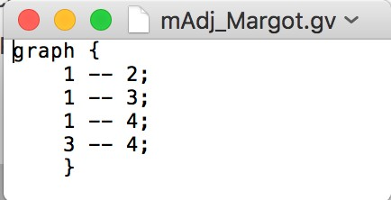
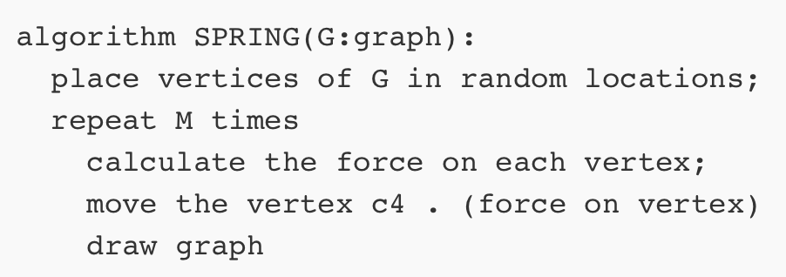
Creando animaciones con Graphviz (Concepto)
Objetivo: usar las herramientas software como caja negra
001.png 002.png
….
…. xxx.png
Archivo.gv
GRAPHVIZ
imageMagic
animacion.gif
1 0 1 0
0 1 0 1
1 0 1 1
1 1 1 1
Matriz A
Archivo.gv

Slide 12
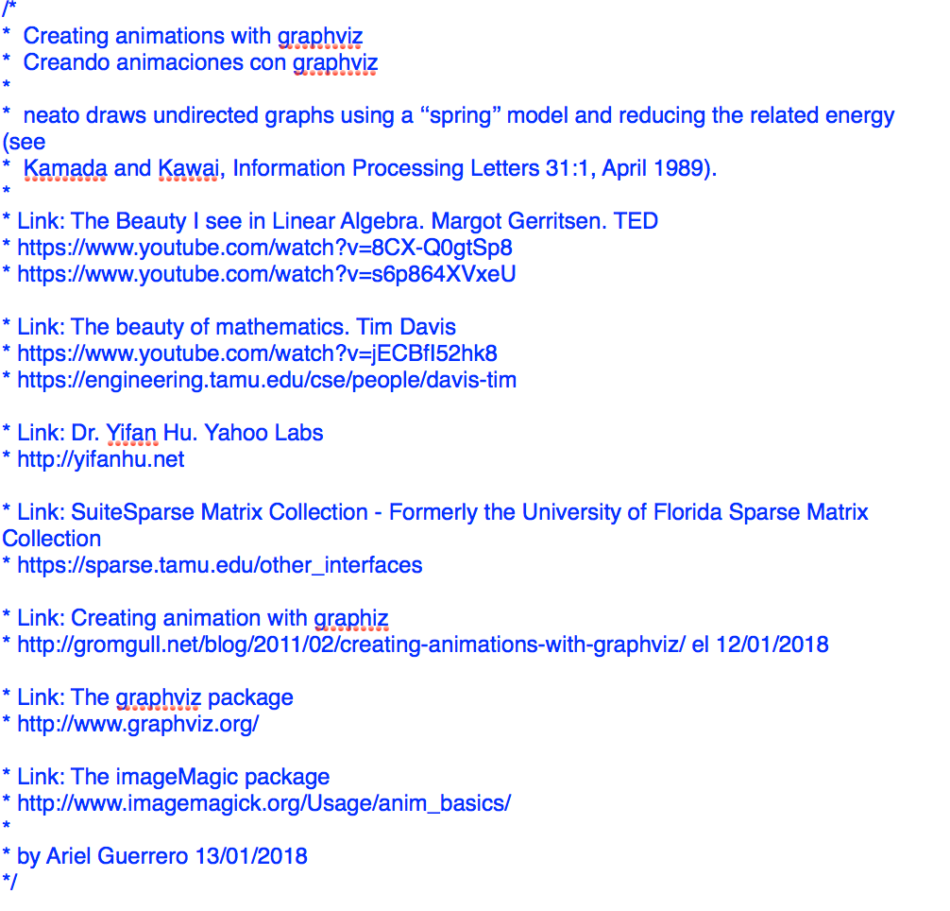
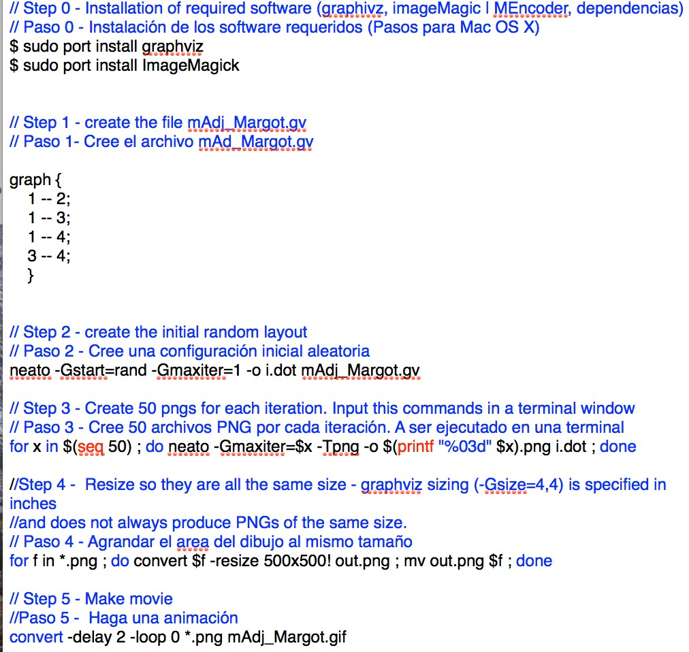
Creando animaciones con Graphviz (Implementación)

Slide 13
Creando animaciones con Graphviz

Slide 14
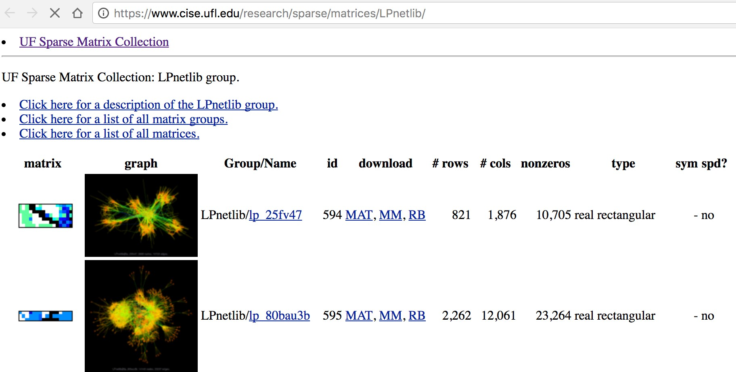
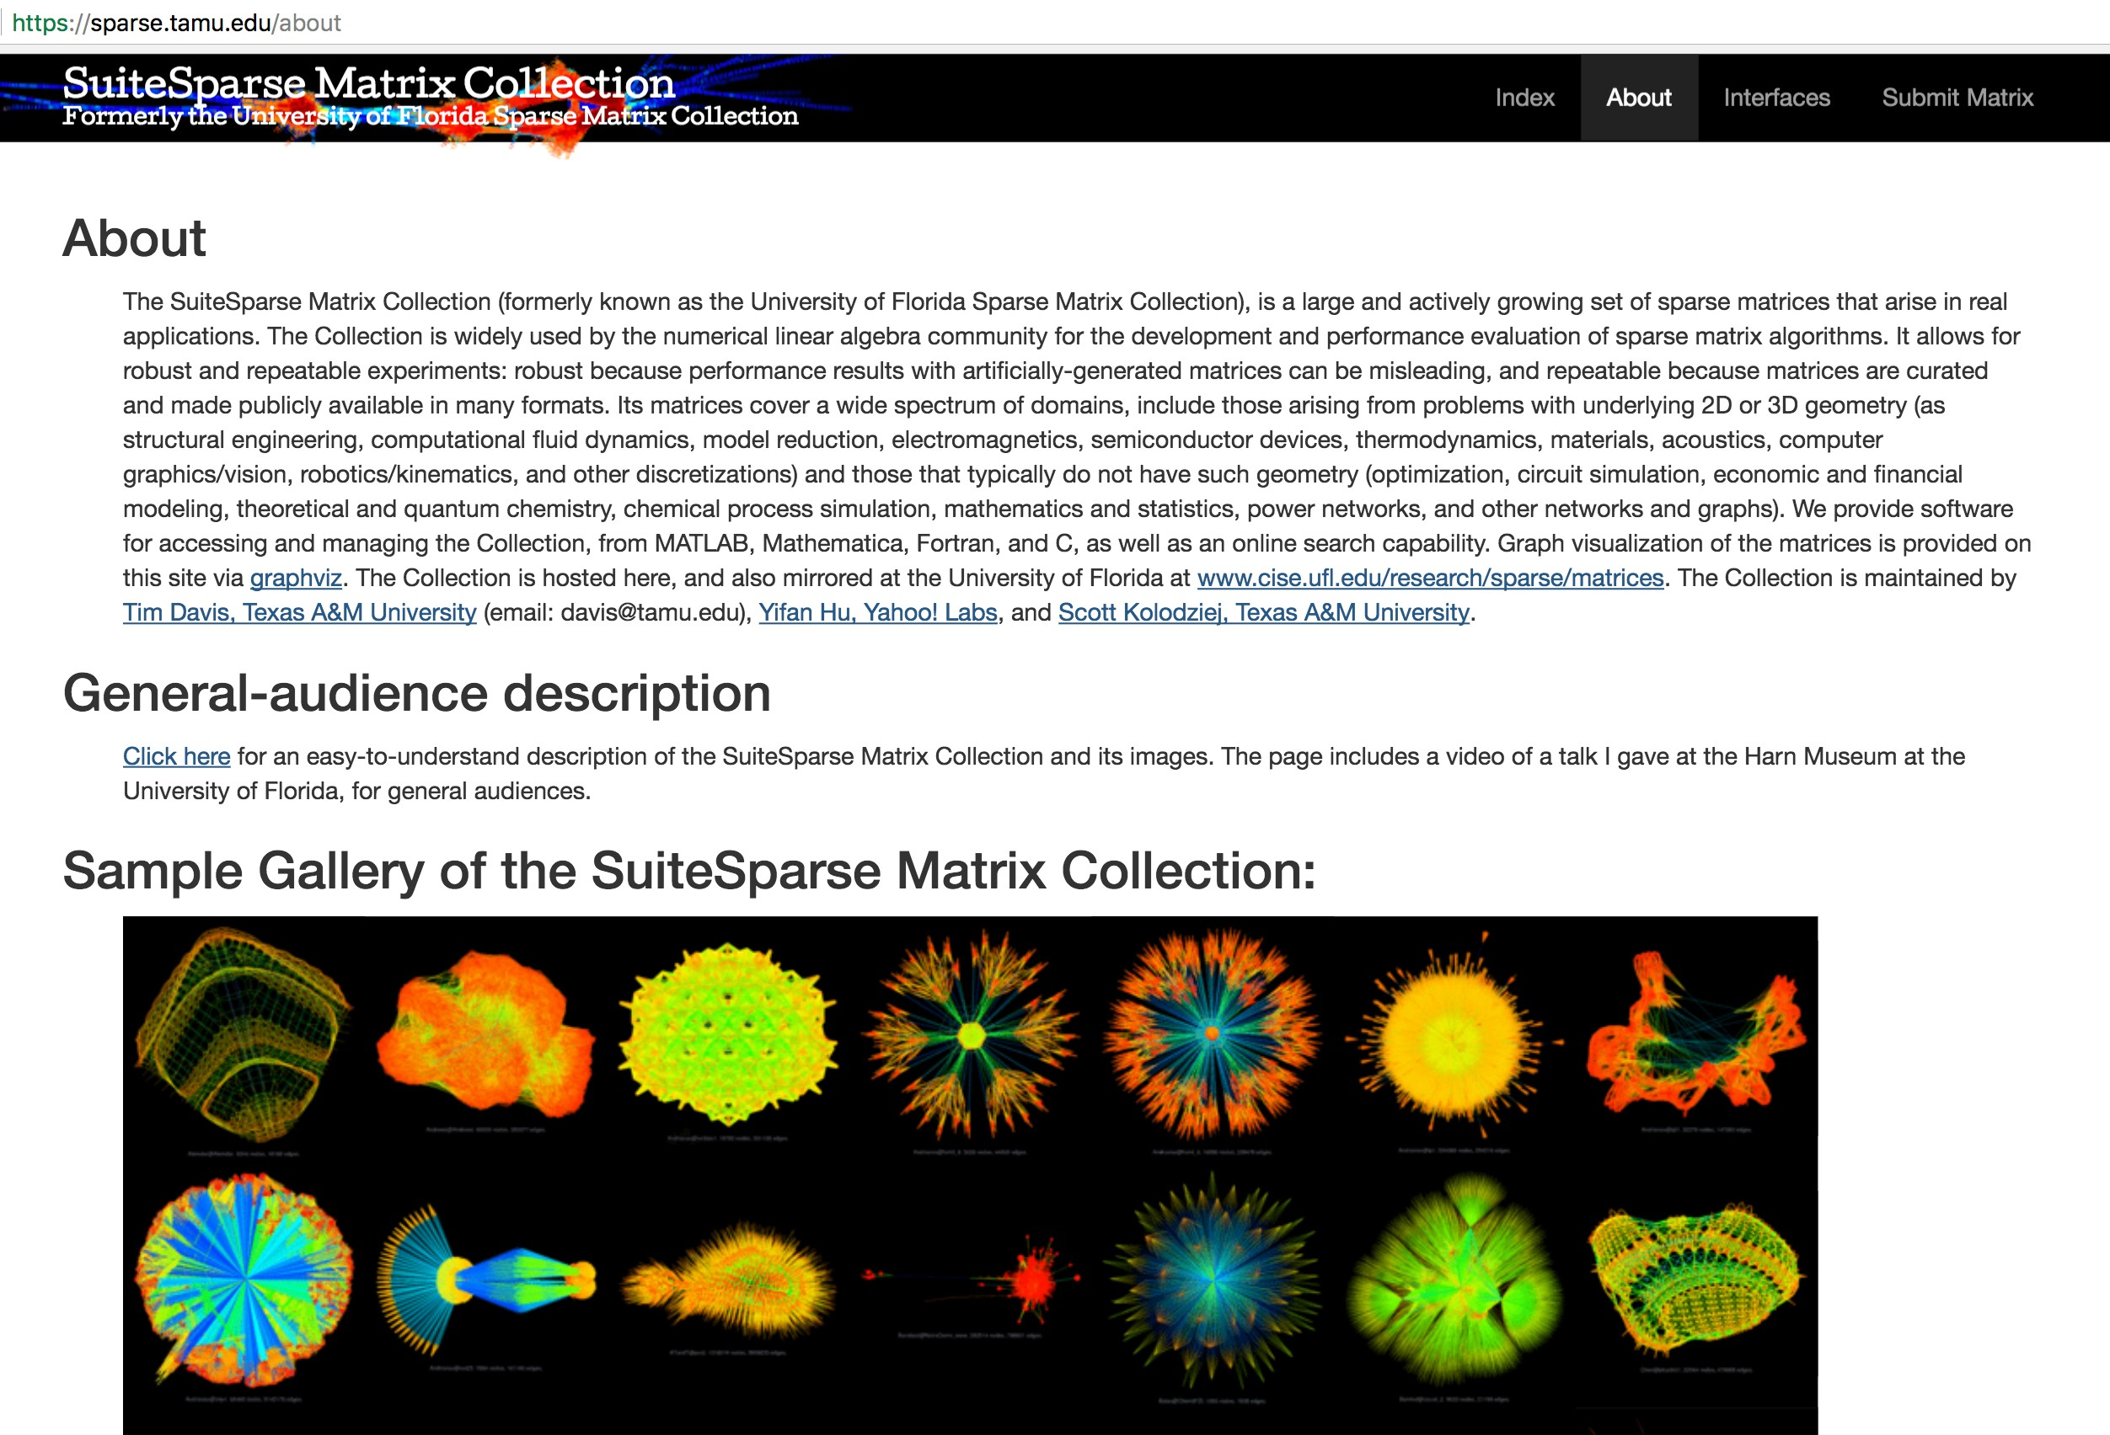
SuiteSparse Matrix Collection
SuiteSparse Matrix Collection
▪ https://sparse.tamu.edu/other_interfaces
https://sparse.tamu.edu/other_interfaces

Slide 15

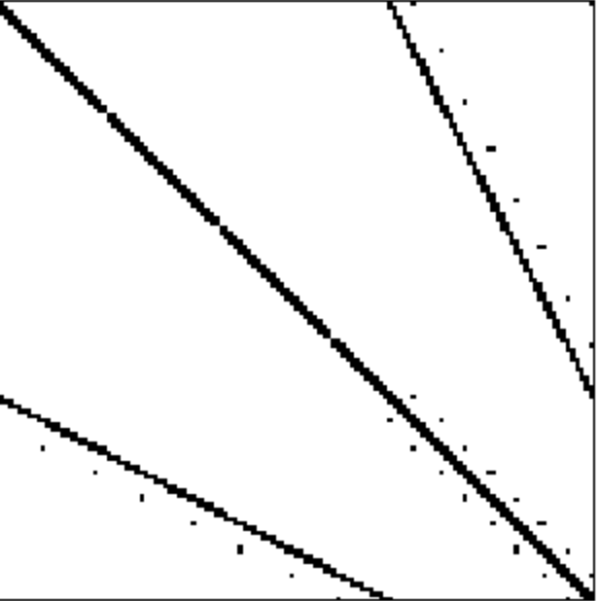
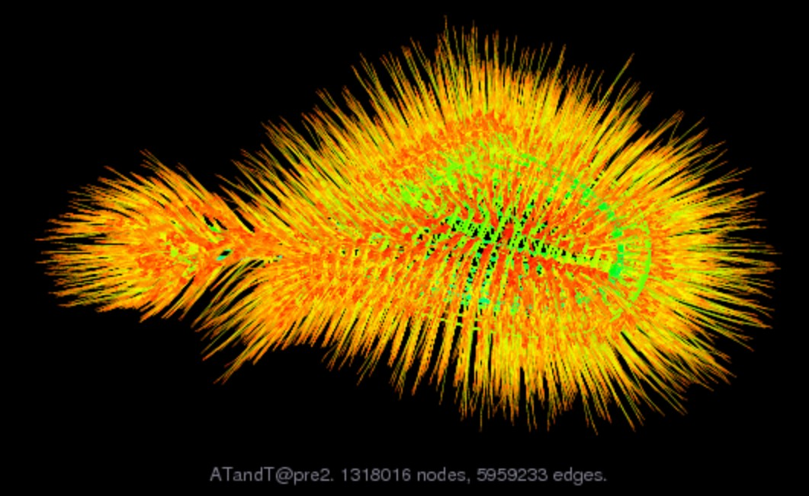
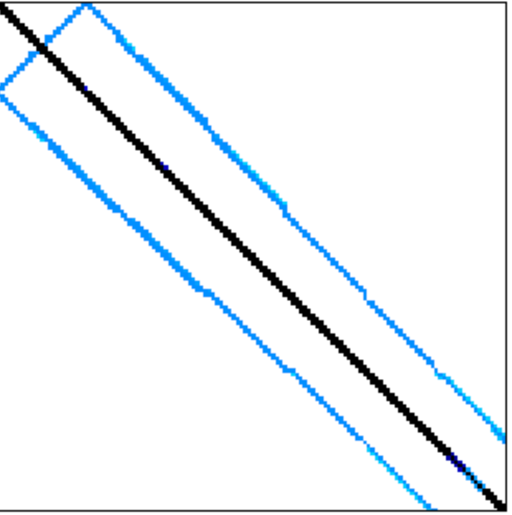
SuiteSparse Matrix Collection
https://sparse.tamu.edu/other_interfaces
Frequency domain circuit simulation problem https://sparse.tamu.edu/ATandT/pre2
Financial Portfolio Optimization https://sparse.tamu.edu/GHS_psdef/finance256

Slide 16
Reto (Challenge)
Grafique alguna de las matrices de la colección de matrices con Graphviz
https://sparse.tamu.edu/other_interfaces
Tiempo requerido: 10 horas

Slide 17
Pasos a realizar
Acceda a la colección de matrices https://sparse.tamu.edu/other_interfaces
Descargue una de las matrices de la colección
Utilice la funcion spy() de matlab para ver su estructura
Genere un archivo en formato dot a partir de la matriz de adyacencia
Grafique alguna de las matrices con Graphviz
Evalué el tiempo que le toma graficar dependiendo del tamaño de la matriz
Escriba un informe y remita al docente

Slide 18
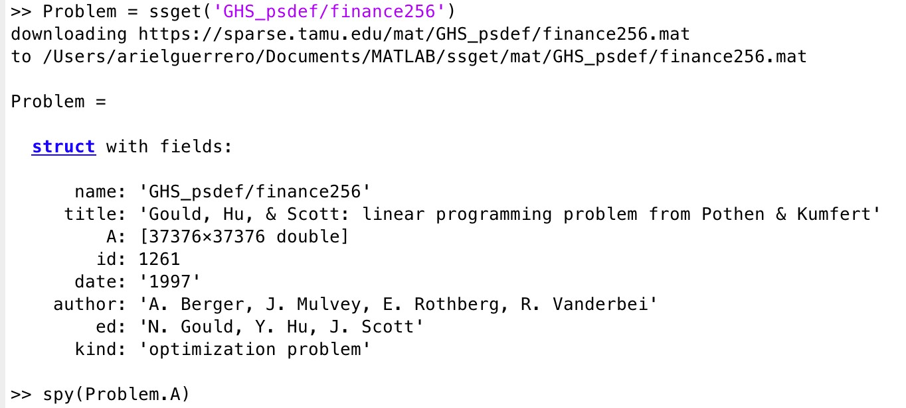
Accediendo a la colección de matrices con MatLab
Financial Portfolio Optimization https://sparse.tamu.edu/GHS_psdef/finance256

Slide 19
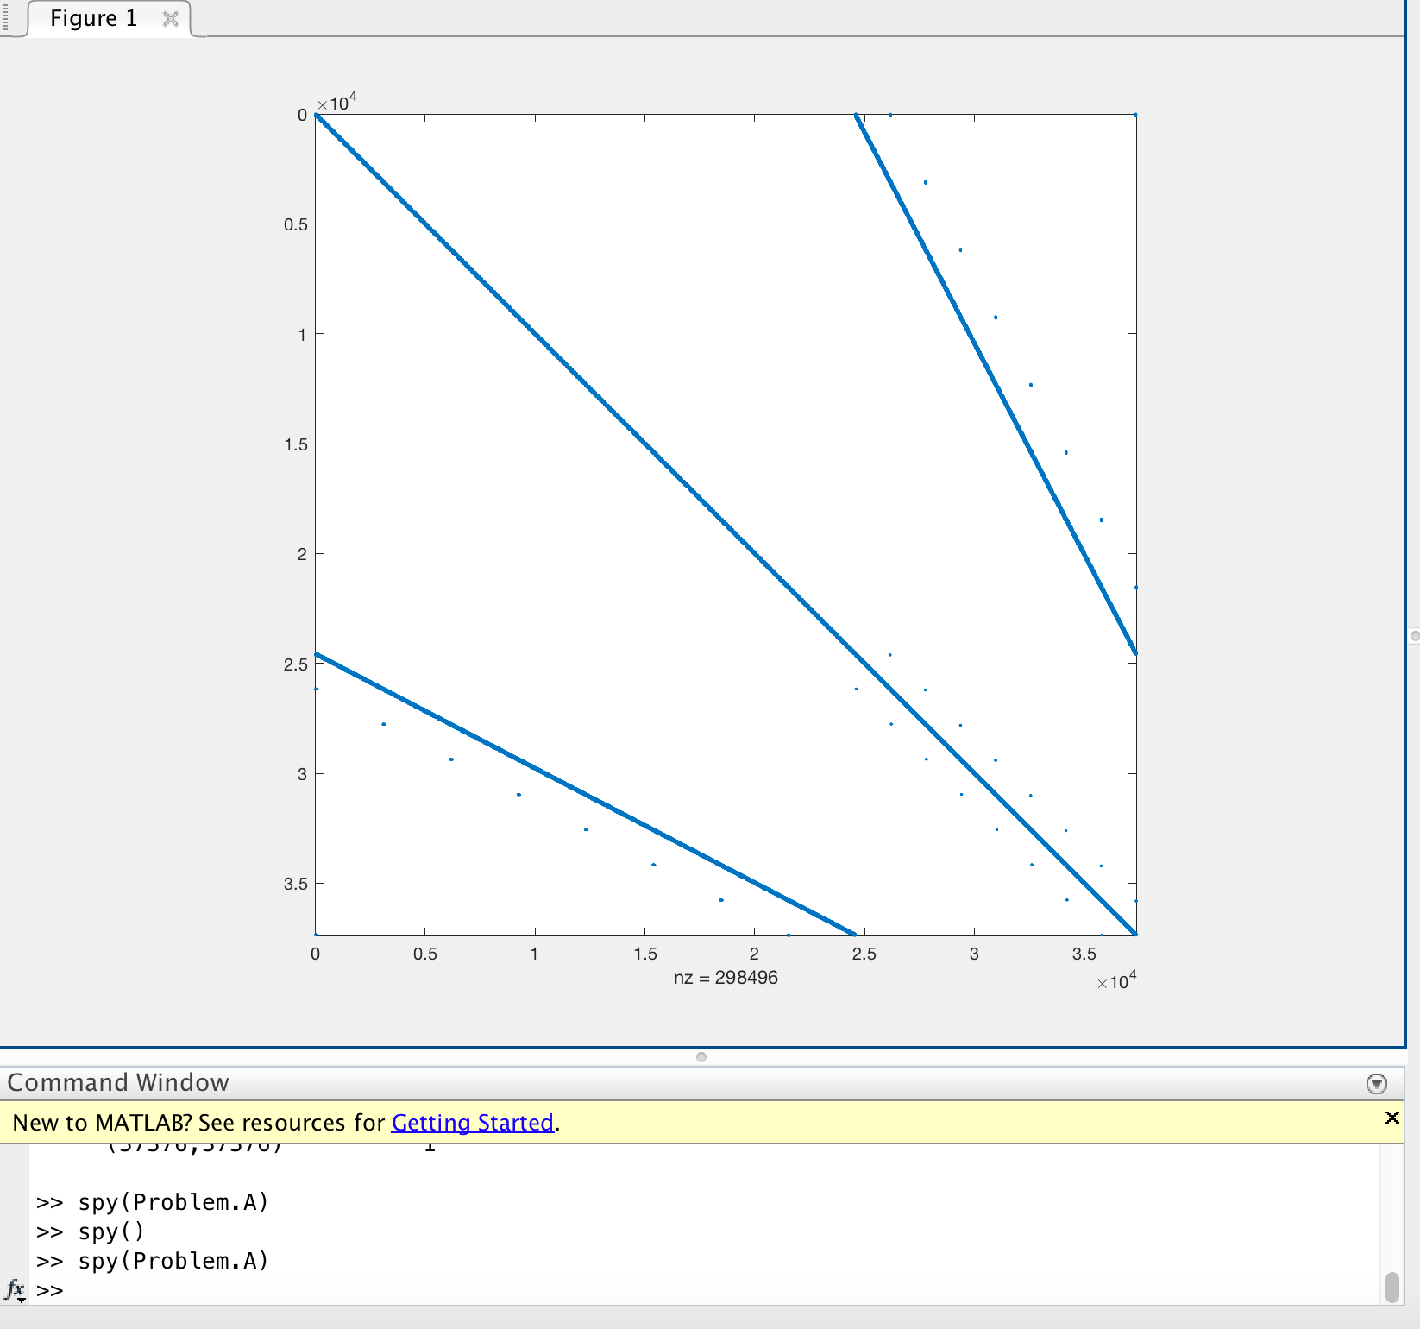
Viendo | el | patrón | de | dispersion | de | una
matriz | en | MatLab
Financial Portfolio Optimization https://sparse.tamu.edu/GHS_psdef/finance256

Slide 20
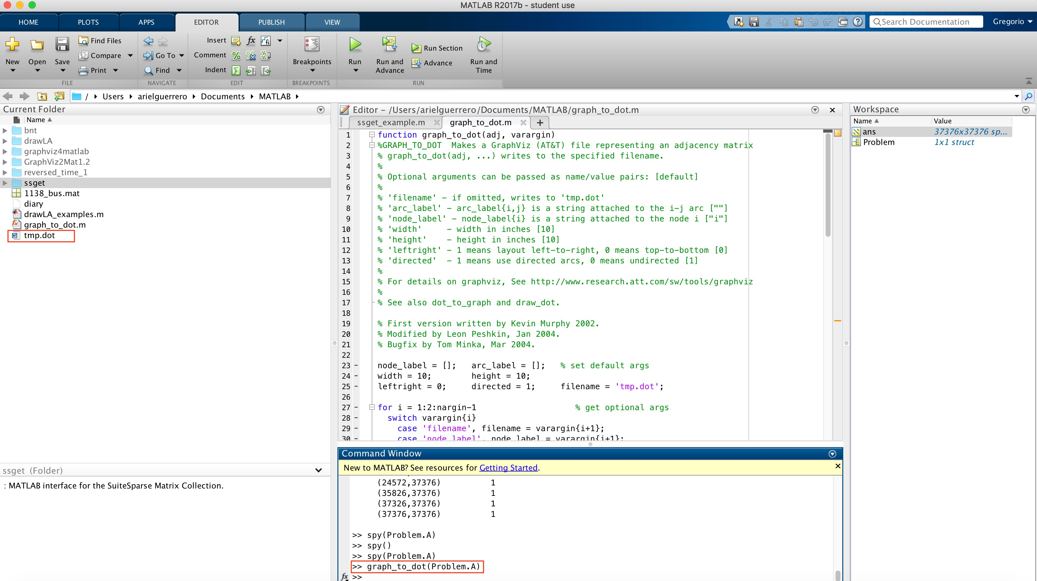
Generando el archivo en formato dot
Financial Portfolio Optimization https://sparse.tamu.edu/GHS_psdef/finance256

Slide 21

Gráfique la matriz seleccionada
Financial Portfolio Optimization https://sparse.tamu.edu/GHS_psdef/finance256

Slide 22
Referencias
Link: The Beauty I see in Linear Algebra. Margot Gerritsen. TED https://www.youtube.com/watch?v=8CX-Q0gtSp8 https://www.youtube.com/watch?v=s6p864XVxeU
Link: The beauty of mathematics. Tim Davis https://www.youtube.com/watch?v=jECBfI52hk8 https://engineering.tamu.edu/cse/people/davis-tim
Link: Dr. Yifan Hu. Yahoo Labs
http://yifanhu.net
Link: SuiteSparse Matrix Collection - Formerly the University of Florida Sparse Matrix Collection
https://sparse.tamu.edu/other_interfaces http://faculty.cse.tamu.edu/davis/matrices.html
Link: Creating animation with graphiz
http://gromgull.net/blog/2011/02/creating-animations-with-graphviz/
Link: The graphviz package
http://www.graphviz.org
Link: The imageMagic package
http://www.imagemagick.org/Usage/anim_basics/
By Ariel Guerrero 13 /01/2018

Slide 23
Muchas Gracias

